Slide 1
Find my Protest
Data Science Tasks
from
Irem and Paula

Slide 2
Collecting multiple JSONL files in DF and filtering out doubles
Verssammlungsbehörde Data:
https://github.com/demodiff/berlin/tree/main/data%2Fjsonl
Json file: versammlungsbehörde ->28.06-21-12-21 every day protest in berlin
more data we could have from here: 2022 - now -> not scraped jet !
> no participants information
> but: location(start, end),route, date, time, topic
Did it manually with Sheets in the end

Slide 3
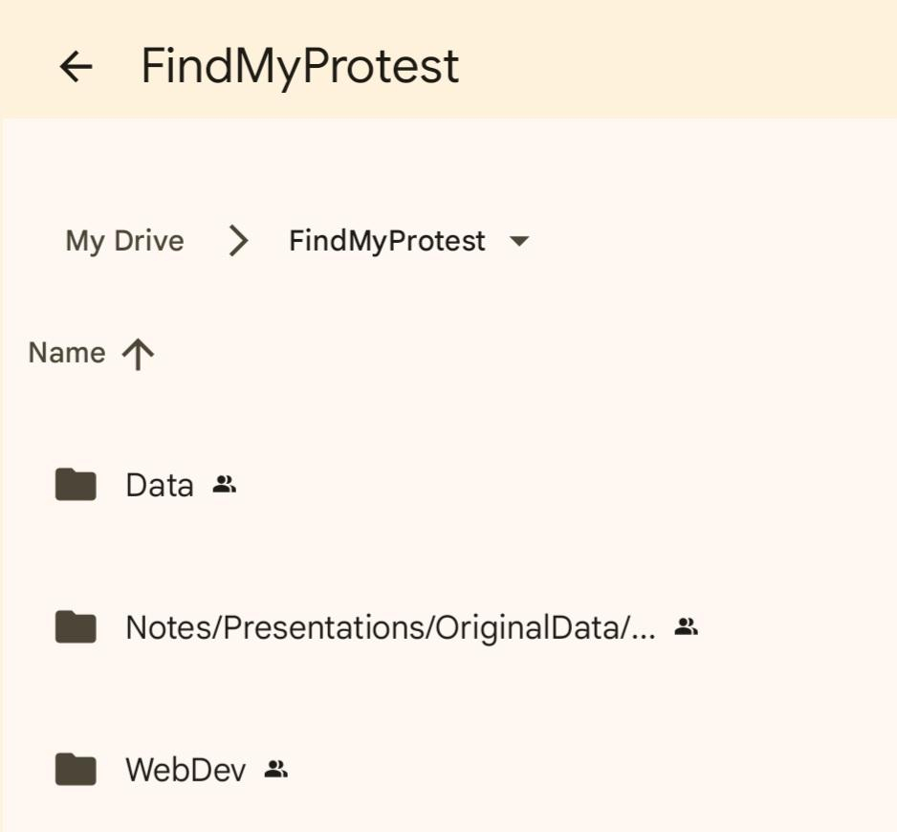
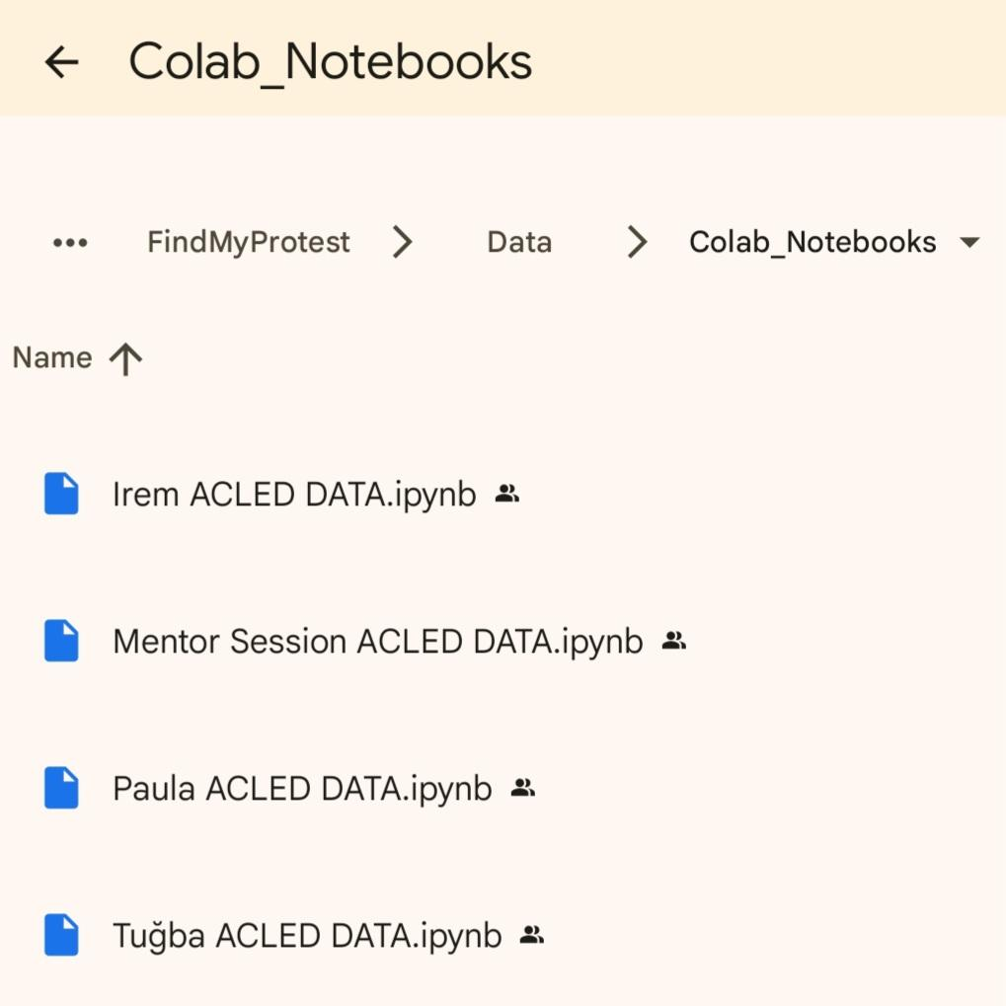
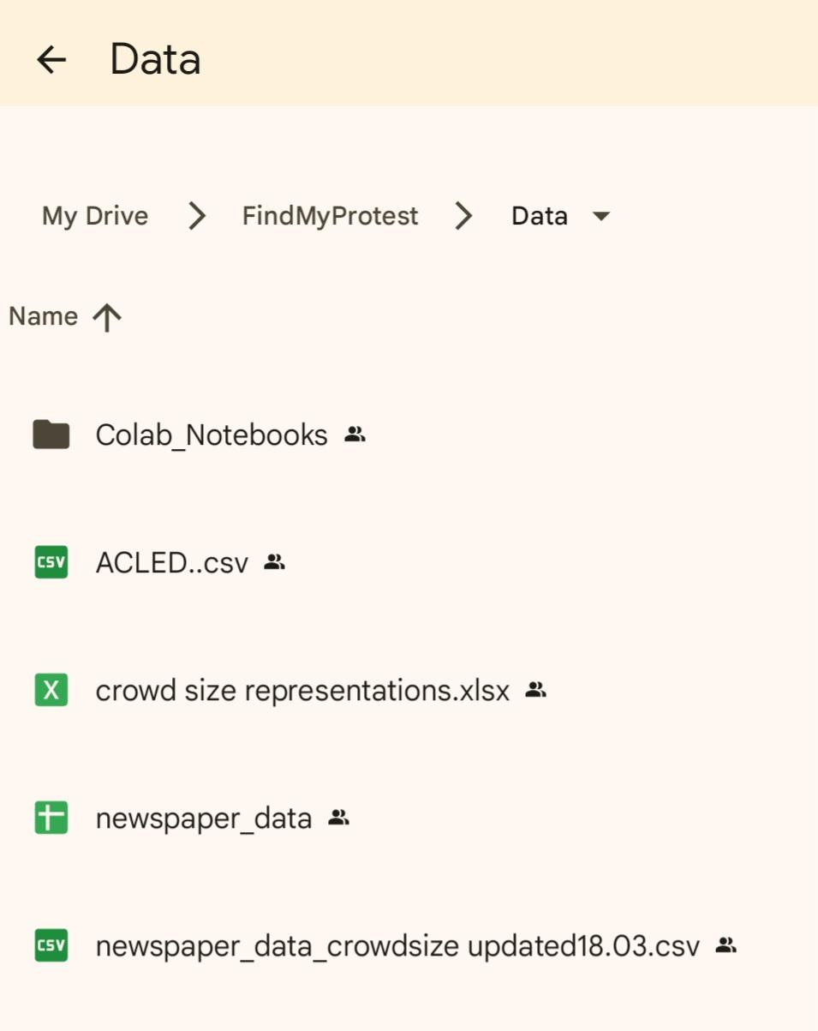
Working with Google Drive: Folders, Sheets, Colab, …
GOOGLE COLAB CONNECTING TO GOOGLE SHEET (GSPREAD)
pip install gspread-dataframe
from google.colab import auth
import gspread
from google.auth import default
#autenticating to google
auth.authenticate_user()
creds, _ = default()
gc = gspread.authorize(creds)
# With this code, Colab gives you a link: by clicking on it you will access your Google account and will be asked to copy a code and to paste it in the ‘Enter verification code’ box; just like that:
LOADING THE SHEET AND CONVERTING IT INTO A DATABASE
import numpy as np
import pandas as pd
#defining my worksheet
worksheet = gc.open('newspaper_data').sheet1
#get_all_values gives a list of rows
rows = worksheet.get_all_values()
#Convert to a DataFrame
df = pd.DataFrame(rows)
pd.set_option('display.max_columns', 100) # Show all columns when looking at dataframe
pd.set_option('display.max_colwidth', None) # show the whole column when looking at dataframe
#creating columns name
df.columns = df.iloc[0]
df = df.iloc[1:]
SAVING DATABASE INTO GOOGLESHEET
#ONLY RUN WHEN 100% SURE YOU WANNA CHANGE SHARED DATA SET !!!
from gspread_dataframe import set_with_dataframe
set_with_dataframe(worksheet, df)

Slide 4
Filtering out and replacing or deleting words:
'between', 'about', 'up to', 'around', 'more than',
'at least', 'a', 'nearly', 'circa', 'at peak',
'in total', 'aproximately', 'arroximately', 'almost',
'over', 'or so', '; local administrators ', ‘,’
'dozen', '12' | 'two dozen', '24' | 'few dozen', '36' | 'dozens', '72'
'a low double-digit', '30' | 'small group', '' | 'quite few', '' | 'large group', '50'
'in the low three-digit range', '150' | 'few hundred', '300' | 'several hundred', '400' | 'hundreds', '600'
'several thousand', '4000' | 'thousands', '6000'
'numerous small groups', '???' | 'groups of[ 0-9]to[ 0-9]', '???' | '70 across 6 locations', '410'
df['crowd_size'] = df['crowd_size'].replace('around 100','100')
# works with the whole column needs regex=True for single parts !!!
df['crowd_size'] = df['crowd_size'].replace(
to_replace=['between ', 'about ', 'up to ', 'around ', 'more than ', 'at least ', 'nearly ', 'circa ', 'at peak ', 'aproximately ', 'approximately', 'arroximately ', 'in total ', 'over ', 'almost ', 'or so', '; local administrators ', 'tractors ', 'caravans ', ‘,’
value='',
regex=True )

Slide 5
Filtering with pandas
manually changed into mean for now:
[0-9,.]to/and/or[0-9,.], 'x+y/2'
filt = (df[‘crowd_size’] …) & (
df.loc[filt]

Slide 6
deleting with .split().str[1] , conversion to NaN with np.nan
to be later deleted :
'numerous', 'crowds'. ‘?’
'no report', ''
# deleting ‘crowd size =’ from the column
df['crowd_size'] = df['crowd_size'].str.split('=').str[1]
# no report with NaN -> NaN not json compliant?
df = df.replace('no report', np.nan)
# you can change NaN in to anything with .fillna('')
df['crowd_size'] = df['crowd_size'].fillna('zero')
# without the fear of NaN values !!
df['crowd_size'] = df['crowd_size'].replace(
to_replace=['no report', 'numerous', 'crowds'],
value='',
regex=True )

Slide 7
Converting columns
string into integer with w2n
'two hundred', '200'
'nine', '9'
Not used in the end

Slide 8
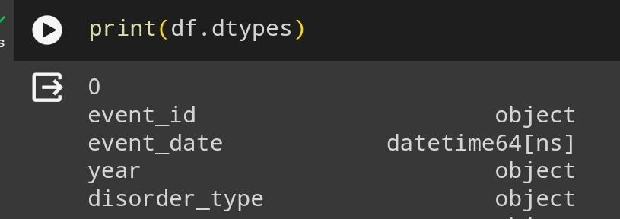
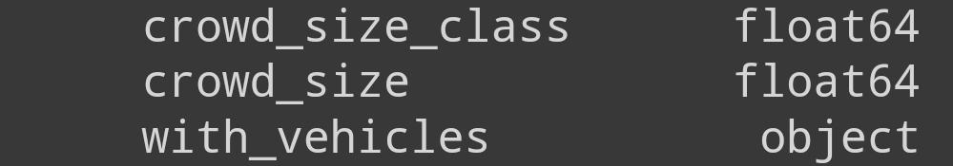
converting string into to_datetime(), to_numeric()
df['crowd_size'] = pd.to_numeric(df['crowd_size'])
df['crowd_size_class'] = pd.to_numeric(df['crowd_size_class'])
from datetime import datetime
df['event_date'] = pd.to_datetime(df['event_date'])

Slide 9
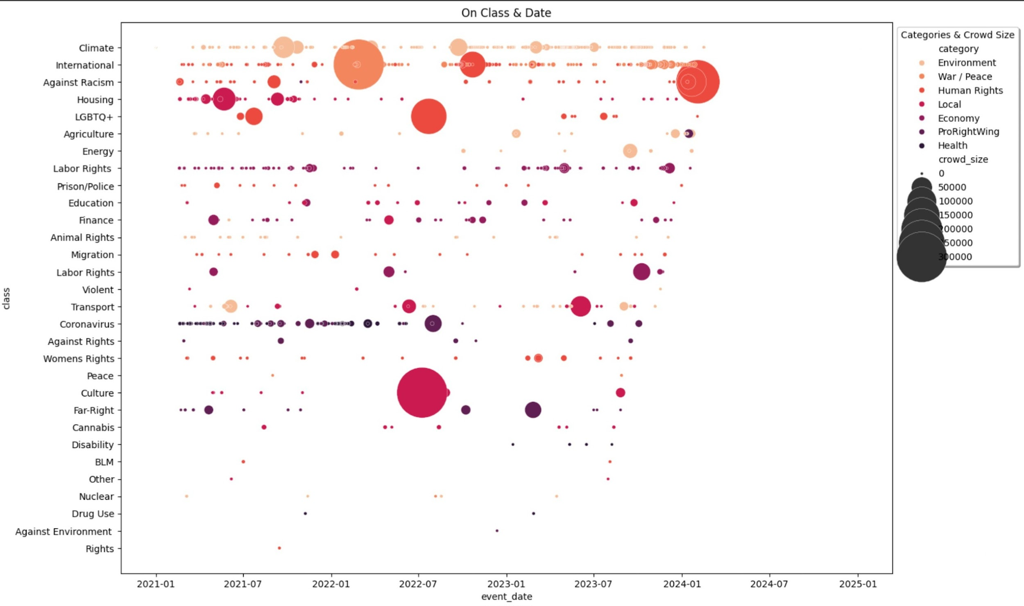
Plotting with matplotlib
SEE CODE HERE:
https://colab.research.google.com/drive/1AU56fPviJ4X2-WLx2e_iZoEja8S2M7vL
SEE MORE RESULTS HERE:
https://docs.google.com/document/d/1R9ezp4YOWTB7N85i3CFqCH7Q-v66ctY09d4ncuwPiH4/edit?usp=drivesdk

Slide 10
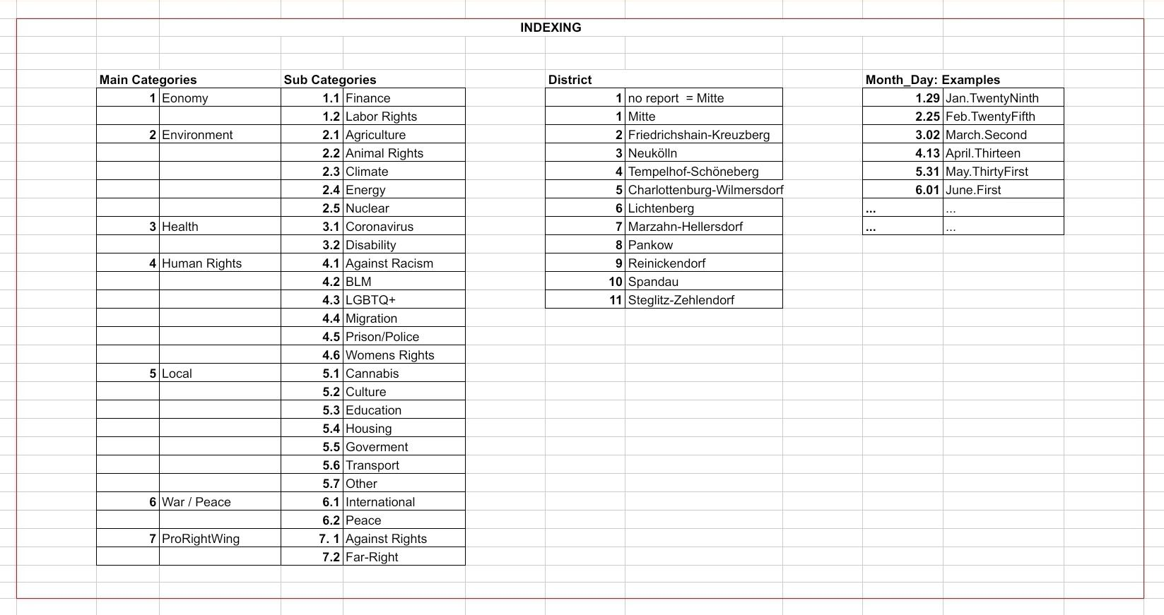
Encoding
RESEARCHED:
Cyclical Encoding: Datetime64
Label Encoding: other written columns like class
ENCODED CONCRETLY:
manually by Indexing

Slide 11
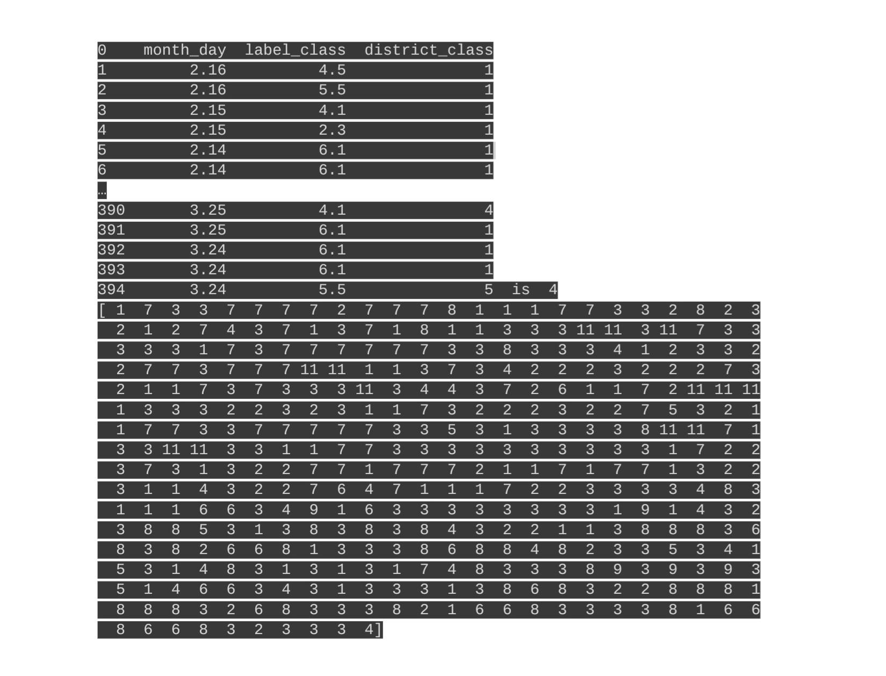
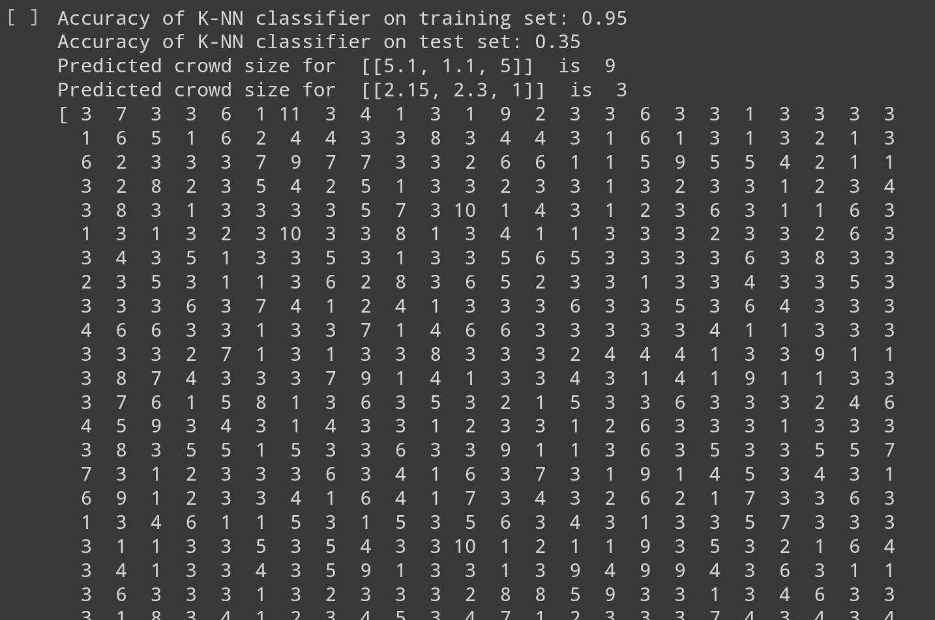
Predictions
with KNearestNeigbours: Predictions on Future Data:
Predictions on old/exisiting data: True

Slide 12
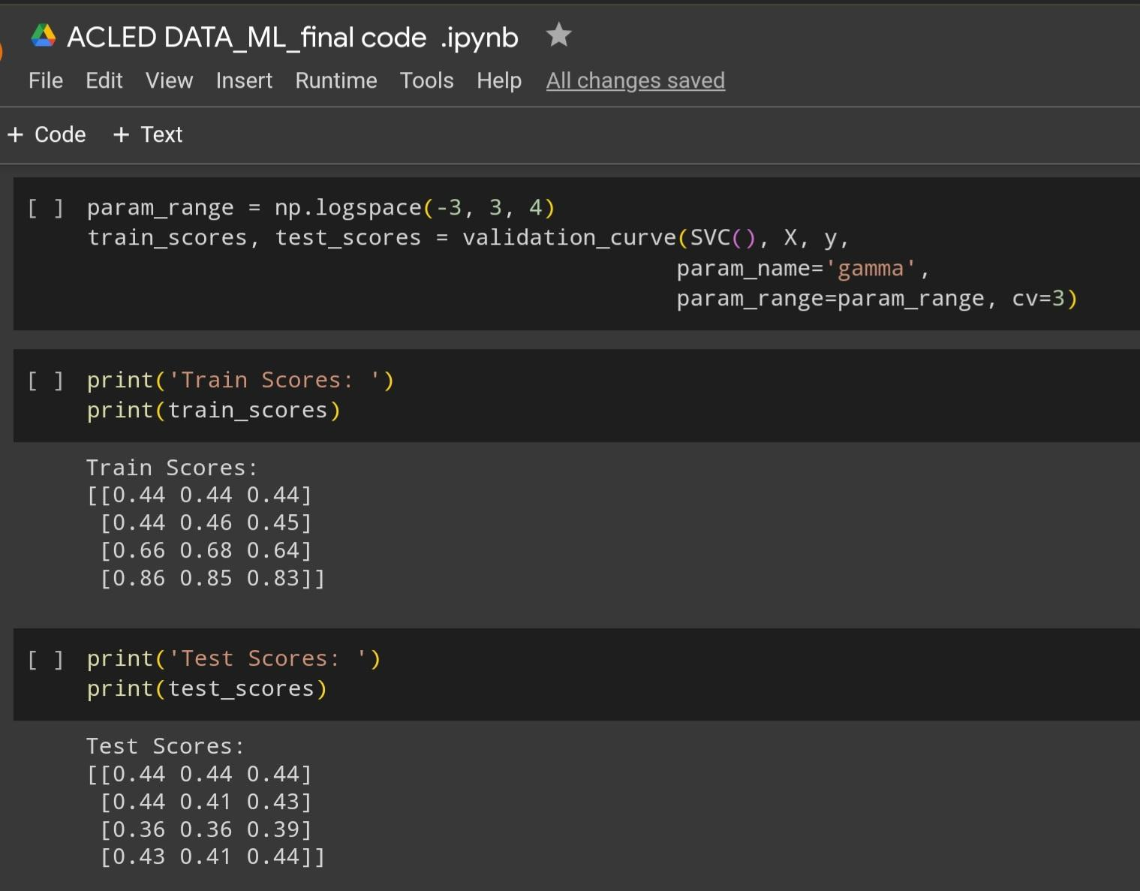
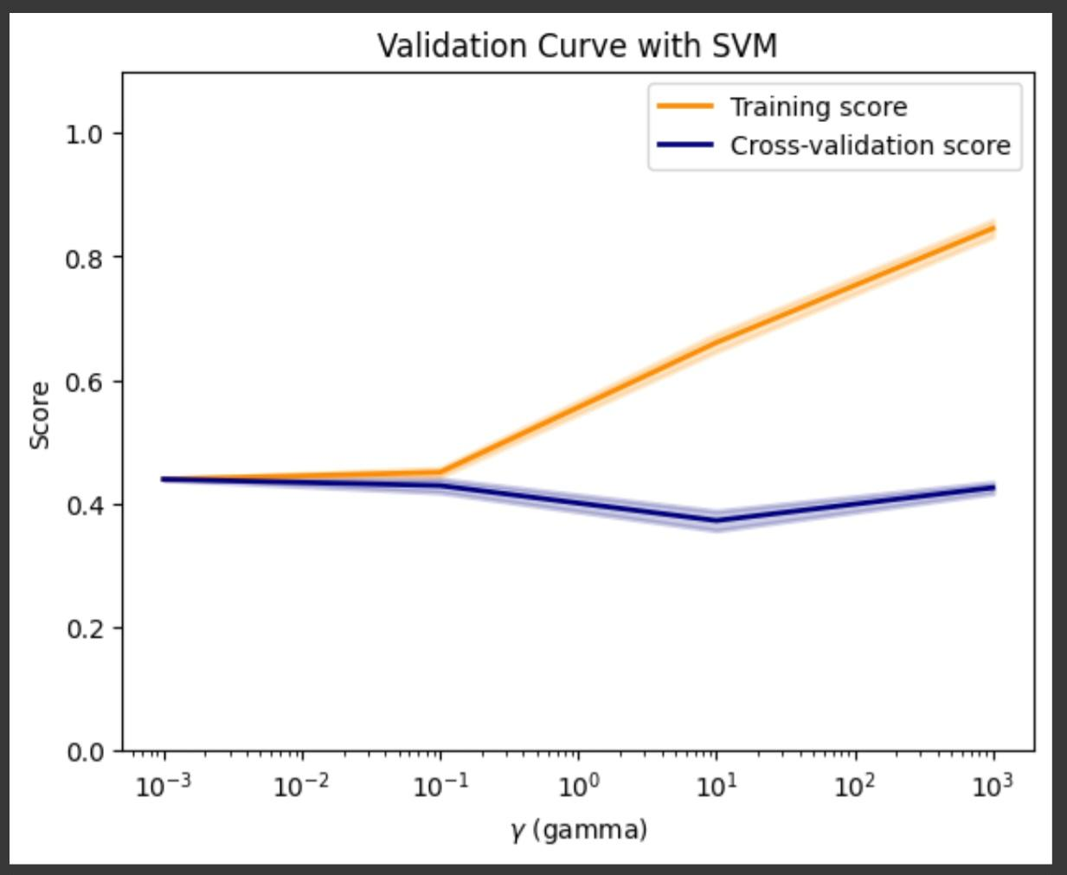
Validation

